Slide 1
Welcome to TU Braunschweig!
www.tu-braunschweig.de

Slide 2

Welcome to TU Braunschweig!
Study in Europe’s Most Active Research Area
36,000 people working in research and development
27 national research institutions
250 companies in the high-tech sector
make Braunschweig the region with the highest level of spending on research and development in all of Europe.

Slide 3
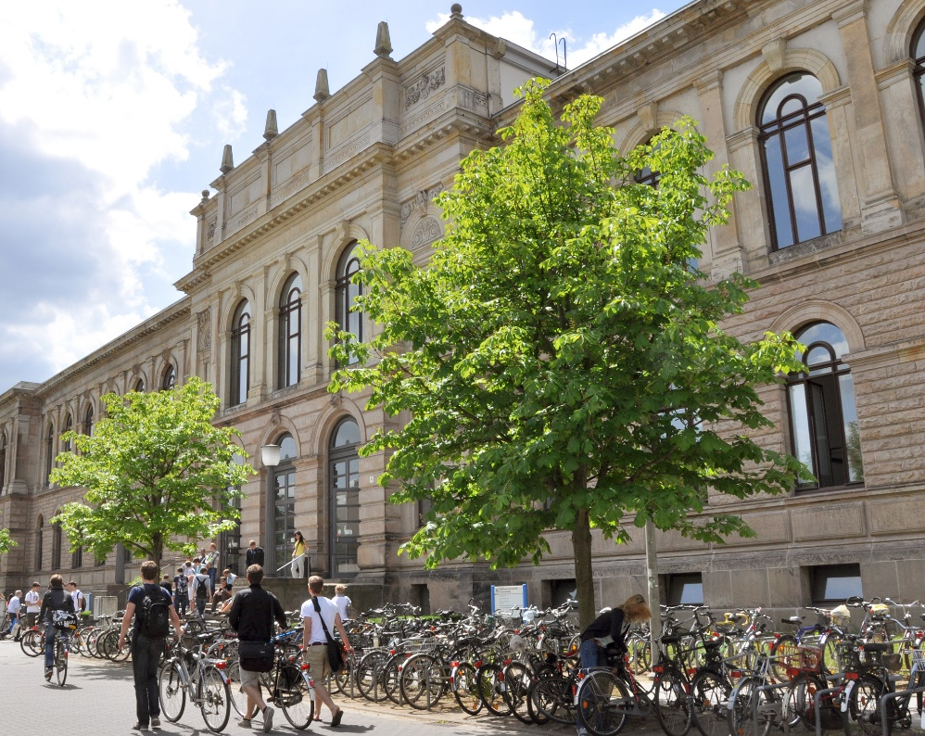
Research and Teaching in Figures
    TU Braunschweig is the academic focal point of these research activities.
    With 86 degree programmes,
    3,279 first semester students,
    16,809 students,
    120 institutes,
    2,088 scientists and
    3,800 university employees
    are we the largest University of Technology in Northern Germany.

Slide 4
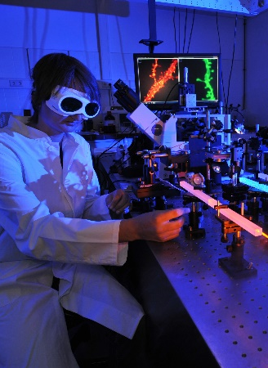
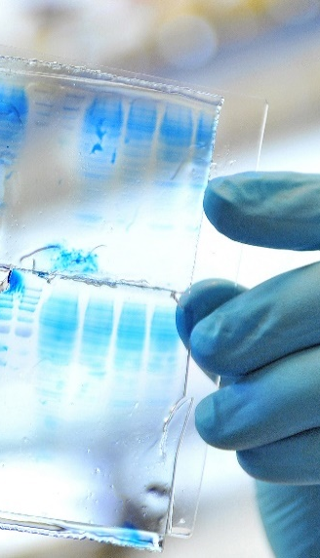
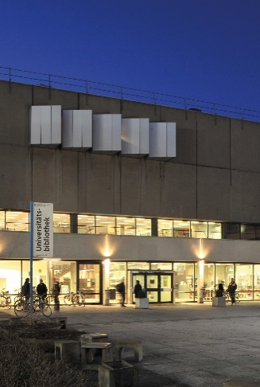

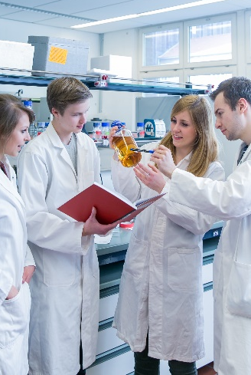
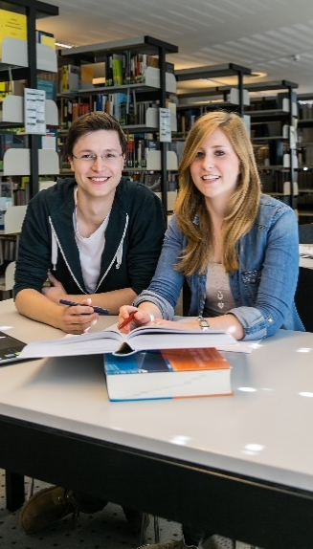
6 Faculties
Carl-Friedrich Gauß:
Mathematics, Computer,
Business and Social Sciences
Life Sciences
Architecture, Civil Engineering and
Environmental Sciences
Electrical Engineering, Information Technology
and Physics
Mechanical Engineering
Humanities and Educational Sciences

Slide 5
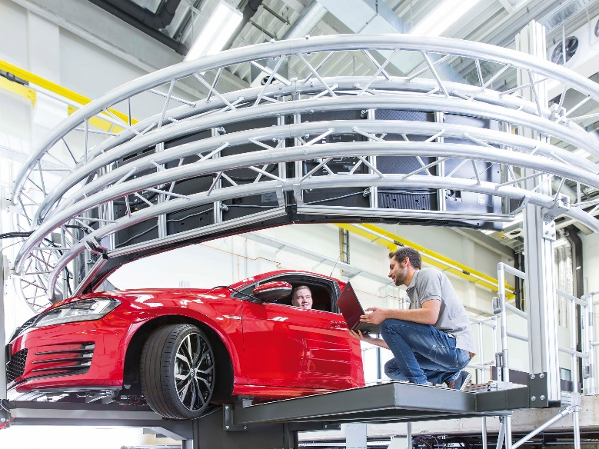

4 Core Research Areas
1
2
2
Mobility
intelligent and interconnected mobility
light-weight vehicles using non-fossil energies
low-emission aircraft
sustainable production
metrology
metrology for nanotechnology
precision at the limits of measurability through quantum technologies

Slide 6


4 Core Research Areas
3
4
Infection & therapeutics
active agents for combating infectious diseases
manufacturing and processing of individualized drugs
Future city
Intelligent strategies for the cities of tomorrow
dealing with advancing urbanization, dwindling resources and climate change

Slide 7

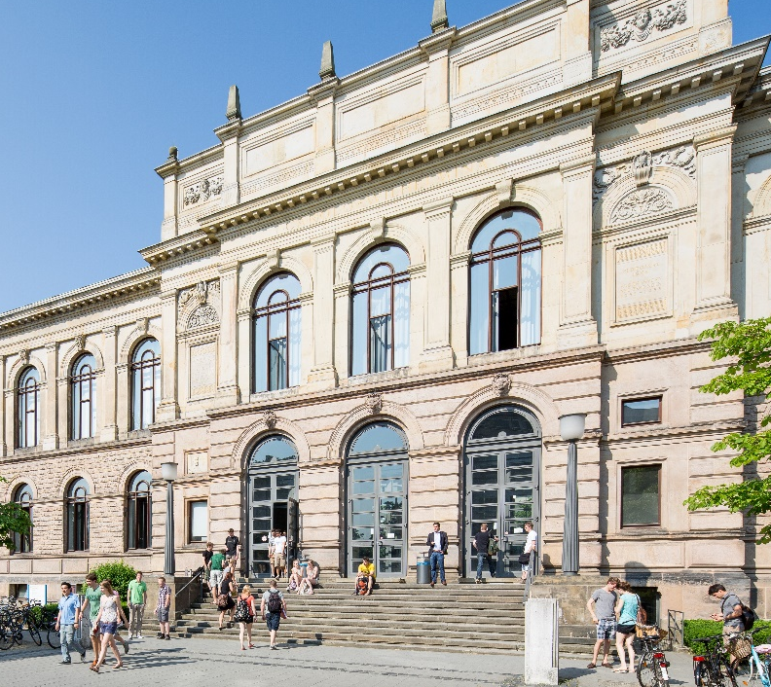
8 Good Reasons to choose TU Braunschweig
    Member of the TU9 (leading Institutes of Technology in Germany)
Student jobs and research projects at local research institutes and major companies like Volkswagen and Siemens
Excellent research and
research-oriented teaching
University with the broadest range of engineering courses in Northern Germany
International profile and open-minded student community
Close collaboration with research and industry
Personal atmosphere and
individual support
Founded in 1745: longest tradition among German Institutes of Technology

Slide 8


International Profile
    3,300 international students from 110 countries
    = 17 % of the student body
    330 partner universities around the world
    170 cooperation programmes with European universities (Erasmus)
    Strategic partnerships with universities in France, Great Britain, Italy, Switzerland, the USA, China, Singapore, Japan, Brazil, Mexico and Australia.
Braunschweig,
Lower Saxony,
Germany

Slide 9

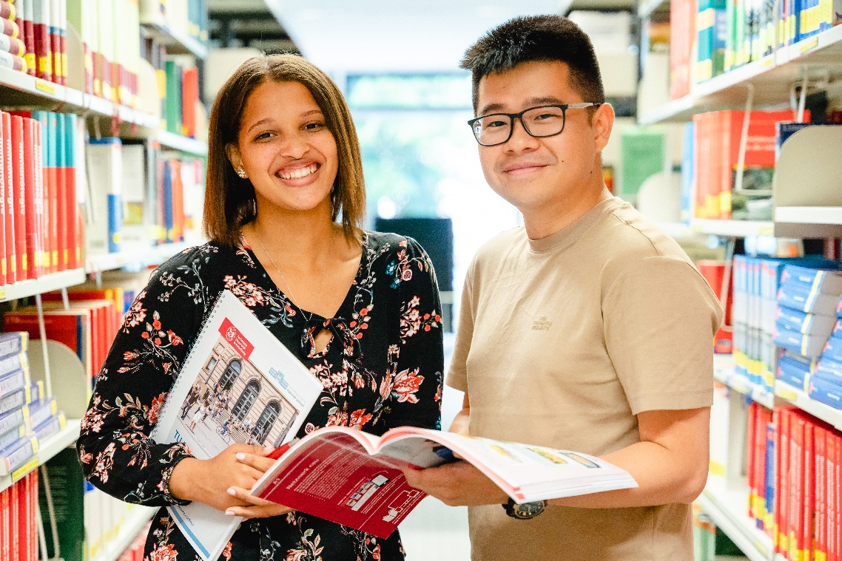
Free Course Choice
Courses can be chosen from different study courses and faculties
https://vorlesungen.tu-braunschweig.de
Tool for English taught courses
Free German and other language courses
www.tu-braunschweig.de/en/courses-in-english

Slide 10
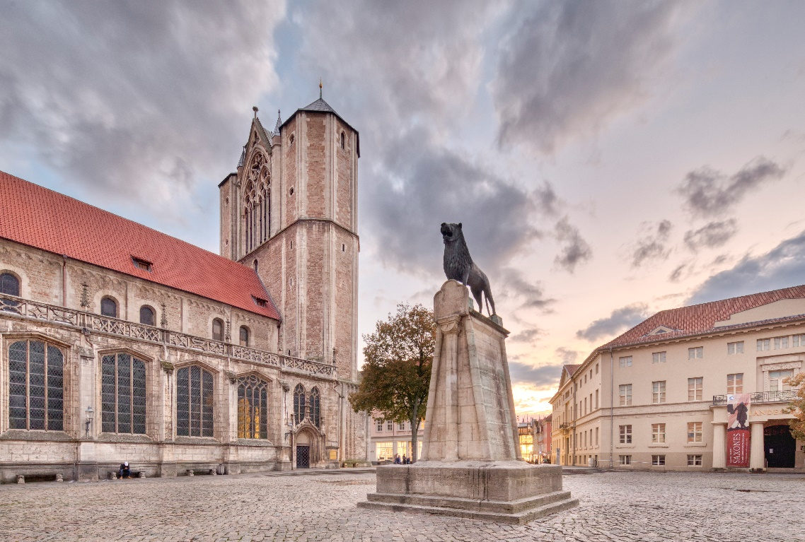

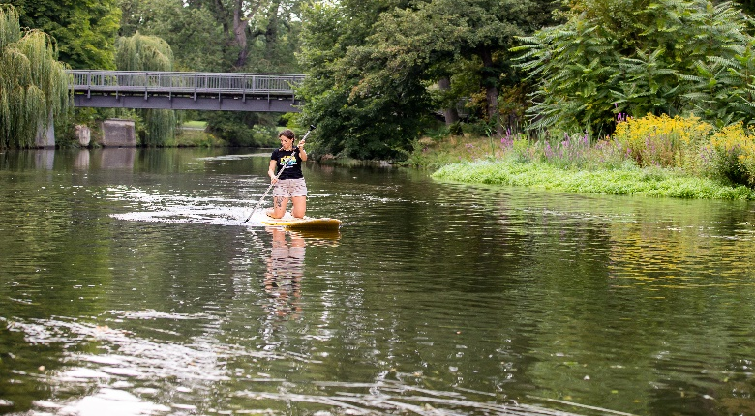

The City of Braunschweig – University and Lifestyle
    friendly and open-minded major city with 248,823 inhabitants from 150 countries
    well-maintained historic city with medieval old town
    Campus in the city centre
    excellent connections to destinations such as the Harz Mountains or the capital Berlin
    short distances
    lots of parks and green areas
    extensive cultural and nightclub opportunities
    broad range of sporting and recreational activities

Slide 11
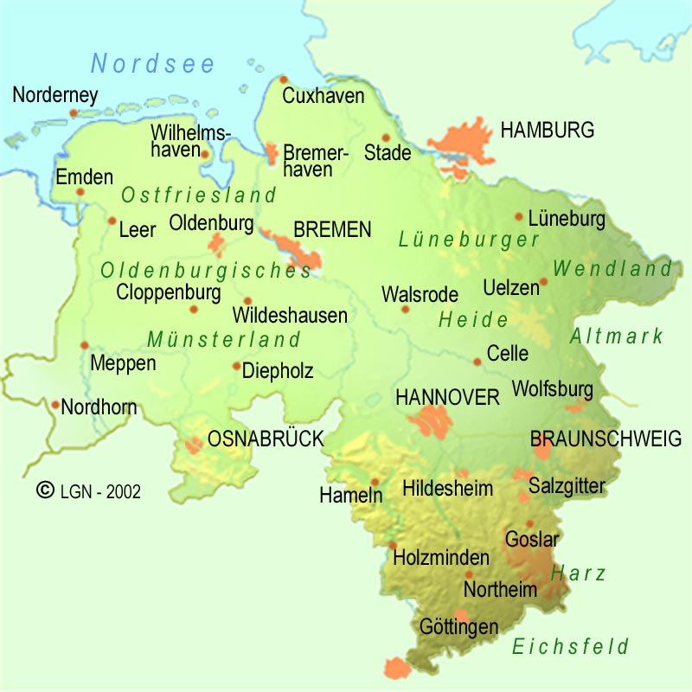
TU Card and Semester Ticket for Lower Saxony
TU Card features:
Semester Ticket
busses and trams in the city
regional trains
Student ID
Library card
Payment card for the cafeteria
Discover our region with the Semester Ticket:
North Sea
Harz Mountains
Luneburg Heath
…

Slide 12
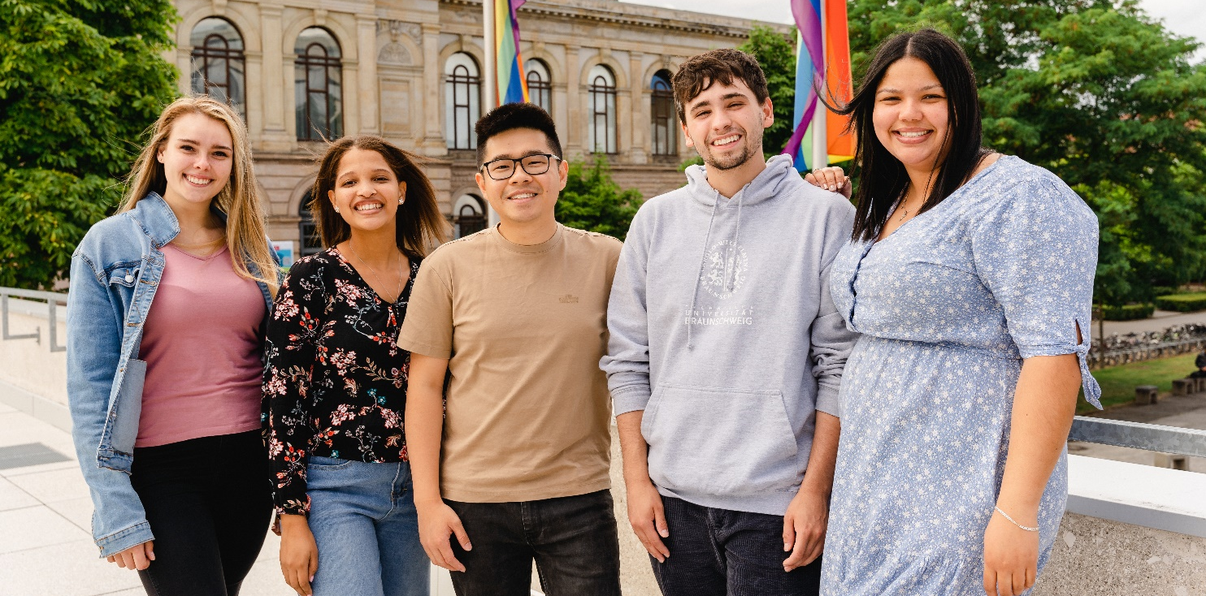

International Student Support
Buddy Programme
Welcome Week
www.tu-braunschweig.de/en/international-student-support

Slide 13
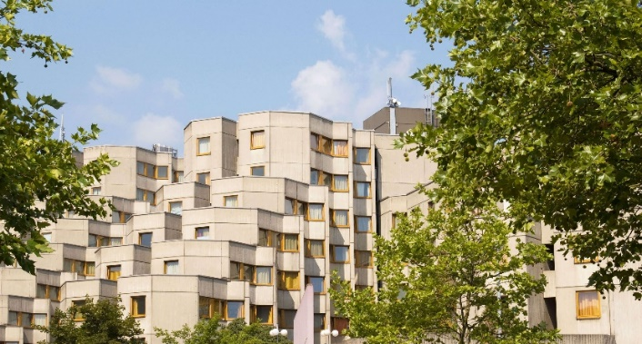
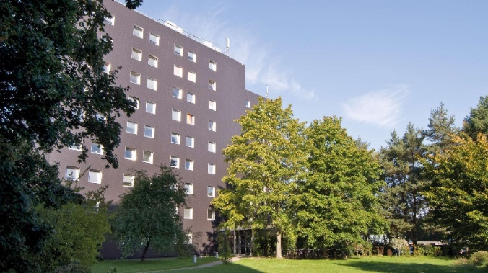
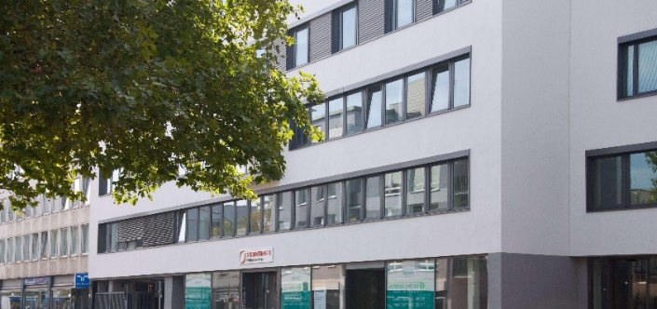
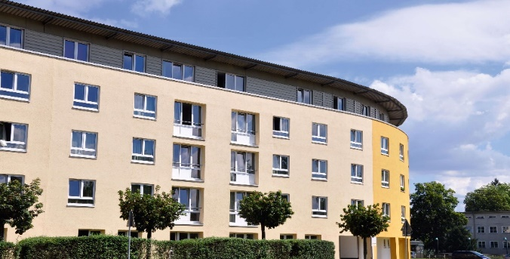
Housing
The Studentenwerk at the TU Braunschweig
has several dormitories with more than 1.800 rooms for students
Accommodation service for exchange students:
The Mobility Office can register exchange students with the Studentenwerk
www.stw-on.de/en/braunschweig/housing/dormitories/

Slide 14

Contact for Exchange Students
Anne-Kathrin Kaiser
a-k.kaiser@tu-braunschweig.de
exchange@tu-braunschweig.de
peerstudents@tu-braunschweig.de
phone +49 531 391 14375

Slide 15
We are looking forward to welcoming you!

Slide 16
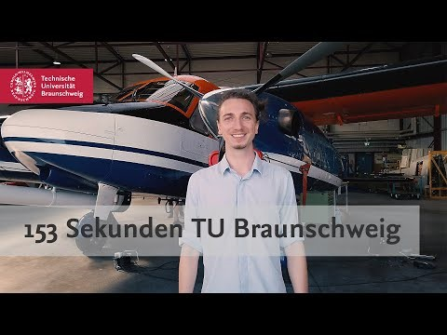
153 Seconds TU Braunschweig
www.youtube.com/watch?v=A5jGY9lYDMo

